Slide 1
Today’s Plan
1
Who am I?
3
How should this class work?
4
Next week’s lab
5
To prepare for next week …
2
What are we doing here?

Slide 2
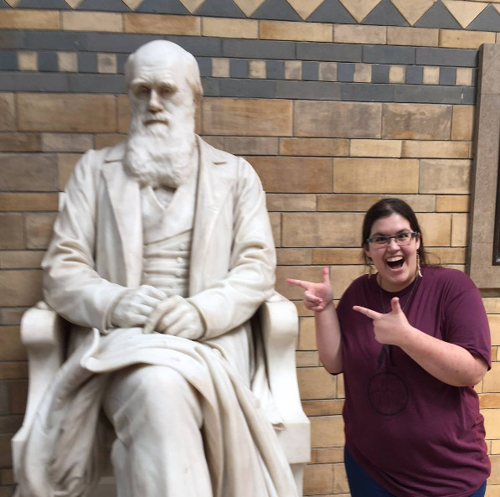
Who am I?
Who am I?
Prof. Stevens (not a doctor)
Office: Herak 310 A
Office hours: Fridays, 11:00 – 2:00
I teach the lab portion of PHYS 104L!
Likes: planets, rocks, weird organisms, and my beautiful baby cats Jimmy and Toepher.
Currently reading: Love Medicine by Louise Erdrich.
Currently playing: Fallout: New Vegas.

Slide 3
What do we want you to get out of this class?
What are we doing here?
Grounded in the mission and identity of their animating tradition, Jesuit colleges and universities seek to offer an education that will transform students and help them to be, in the words of former Jesuit Superior General Adolfo Nicolás, “converted to humanity."
Their emphasis on developing the whole person relies not only on the communication of content, but also on the quality of relationships among a wide community of educators and co-learners. Within that community of scholars, each student grows to appreciate that the life of the mind can bring unanticipated joy. Discovering how to think analytically, reflect, imagine, communicate, and create enlivens their intellects and nourishes their spirits.

Slide 4
What do we want you to get out of this class?
What are we doing here?
How do we pursue knowledge and cultivate understanding?

Slide 5
THE BIG QUESTION THE BIG GOAL
What are we doing here?
How do physicists use data to make meaning of the world?
Using raw data, build a model describing how two variables in a system affect each other.

Slide 6
What do we need to accomplish that goal?
What are we doing here?
To know that our data are reliable as possible.
To notice and account for possible sources of unreliability.
Can we compensate for them?
If not, we can at least identify them.
Identify trends
What are our data doing on average?
How much deviation from that average do we see?
Interpret those trends
Can we summarize those trends?
Can we use those trends to make predictions?
Can we explain those trends in real-world terms?

Slide 7
How are we going to get there?
What are we doing here?
Build a skills toolbox
Learn to quantify error
Identifying Trends
Instrumentation skills
Understanding the basics of uncertainty: reliability, spread, and error
First: quantifying the precision of your instruments
Then: quantifying overall precision and accuracy in your data
Graphing linear data
Linear regression analysis
What do these trends tell us?
Testing pre-existing models
Building models from scratch!
To end the semester, a bit of a gear shift: how do we study systems that we can’t directly interact with?

Slide 8
Drop-In Lab Format
Syllabus Highlights
The Basics
FAQ
Lab Room: Herak 257
Open Hours: 10:30-8:00, T/Th
Drop in and do the lab when the room is open!
Labs will take ~2 hours to finish
You may not begin a lab later than 6:30 pm
Group work is allowed but not required
Syllabus ref: pgs. 1-2
Can I split the lab up over multiple sessions?
Yes!
Can I take the lab home to finish?
Yes!
Can I start the lab without my groupmates or leave before they’re finished?
No!
If one groupmate is sick or can’t make it, do we all have to wait to do the lab until they’re better?
No!
Ugh, do I have to work in a group?
Group work is optional!

Slide 9
Where your lab grade fits in
Syllabus Highlights
Reflection Discussions (five throughout the semester) → complete/incomplete
PHYS 104: One grade will show up on your transcript (A, B, C, etc.)
75% of your final grade comes from lecture.
This part of the grade is based on whatever criteria your lecture professor sets.
25% of your final grade comes from the lab → Must get C- or above!
Learning Labs (10)
35% of lab grade
Capstone Labs (4)
35% of lab grade
Canvas Quizzes
25% of lab grade
RD
5%
Labs where you’re learning new stuff.
Learning targets numerically “graded” on a proficiency scale from 0-4 for feedback.
BUT! The grade in gradebook is C/I!
Each missing lab is -10% to overall LL grade.
Labs where you show off what you’ve learned.
Each LT will be assessed on a proficiency scale from 0 – 4.
Averaged, scaled like a GPA, goes in the gradebook!
Lowest will be weighted down by half.
One a week, ~10 q’s.
MC, 2 tries, highest grade recorded.
Graded by Canvas using simple %.
Lowest dropped.

Slide 10
Here’s how to pass PHYS 104
Syllabus Highlights
Do whatever your lecture prof said to do.
Complete your learning labs.
Achieve at least a 1.7 on all capstone labs.
Achieve an average of at least 70% on your quizzes.
Do your reflection discussions.

Slide 11
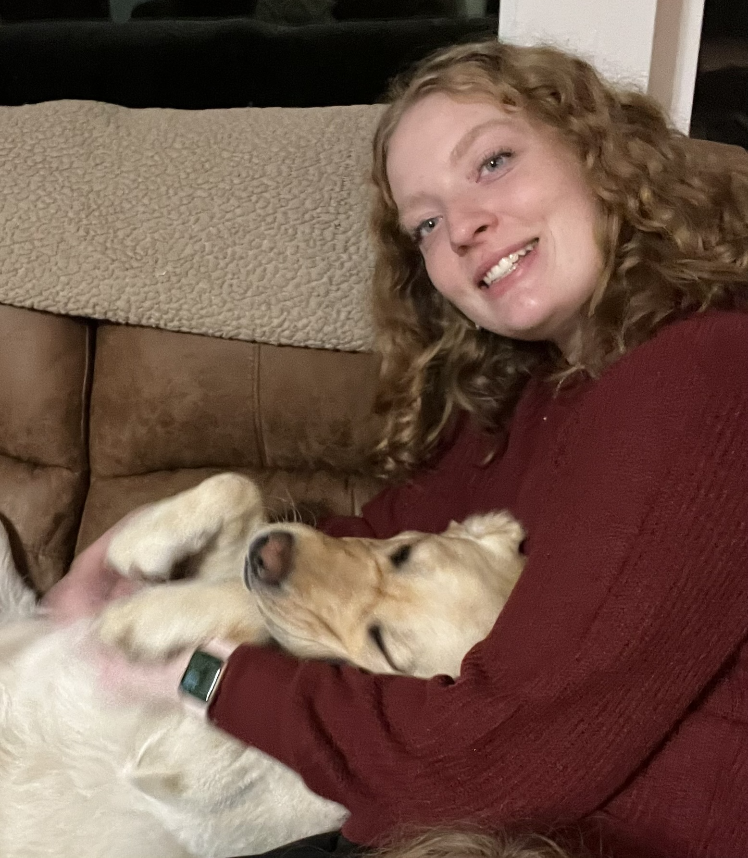
TAs
Syllabus Highlights
Rylee (Thursday, ~3:15-6:15)
Grace (Tuesday, ~4:30-7:30)

Slide 12
Pre-Lab Lecture Routine
How should this class work?
The Basic Deal:
Come to class!
We’ll discuss skills and/or ideas central to this week’s lab
We’ll sometimes do in-class activities.
What this means
Occasional group work/partner work. Usually informal.
Open questions to the class that I expect to hear some guesses for!
My role: teacher

Slide 13
Lab Routine
How should this class work?
ASK ME QUESTIONS EVEN IF I LOOK BUSY!!!
The Basic Deal:
Come on in
Check in with me
Grab a lab packet
Work through the lab!
What this means
Self-paced
Fairly independent
My role: facilitator

Slide 15
Mystery Tubes!
Models
What’s going on inside of this tube?
You will answer this question by using “the” scientific method to build and test a model!
Then, you will see what another group thinks about their tube, and you’ll test their hypothesis.

Slide 16
The Purpose of Science
Models
Take a minute to briefly brainstorm some reasons why people do science.

Slide 17
The Process of Science
Models
Messy!
Not predetermined!
Iterative!
Collaborative!

Slide 18
Essential Parts of an Experiment
Models
KWL Chart
Know: What do you already know about this?
Want to know: what questions do you have about this?
What we’ll do:
1 min: fill out “Know” and “Want to know” independently
2 min: talk w/neighbors, compare notes, add to “learned/remembered”
Try to leave a little room in “learned/remembered”!

Slide 19
Essential Parts of an Experiment
Models
Hypothesis
Prediction of an outcome that might happen when we study a system.
We use our current understanding of that system to make these predictions: if our idea is correct, then our predictions ought to come true.
Constants
Variables or factors that you attempt to keep the same throughout an experiment.
By keeping constants the same, you can better isolate the effects of the variables that most interest you.

Slide 20
Essential Parts of an Experiment
Models
Independent Variable
The variable or factor that is intentionally varied by a researcher in an experiment or study, OR
A variable that you believe controls the response of a system, but you cannot vary it. In those cases, that is typically something like time.
Dependent Variable
The variable or factor in a system that may change as a result of changes made in the IV. It’s really, in the end, what you’re interested about in a system.

Slide 21
Distinguishing IV vs. DV
Models
Method 1
Method 2
Write an if/then/because hypothesis.
If [I do this], then [this will happen], because [here’s how I think the system works].
If IV, then DV, because …
What are you interested in?
Usually the DV!
What do you think controls it?
Usually the IV!

Slide 22
Your To-Do List
To prepare for next week …
EMAIL ME if you have not received an invite to Canvas.
stevensl@gonzaga.edu
Note! I’m in the process of sorting you into sections.
Pre-Lab Reading
Lab 1 Module on Canvas!
Give it a read before coming into lab, and use as reference on the lab.
First lab: drop in next Tuesday and/or Thursday
To find a group: Lab Partner Discovery Thread in Lab 1 Module
Useful scheduling website: when2meet.com
Your first quiz!
On Canvas, due next Friday at 5:00pm. I recommend finishing your lab before taking the quiz.

