Slide 1
Today’s Plan
LAST LAB!
WE’RE DOING IT! WE’RE SO CLOSE!
PS – pre-lab quiz this week!
Scale Calculations
Reflection & Rutherford
EXPLORE THE ZONE OF MYSTERY!
Logistics

Slide 2
THIS WEEK’S SYSTEM THIS WEEK’S QUESTION
Reflection and Rutherford
The ZONE OF MYSTERY!!
How can we use the principles of reflection to determine the size and shape of the hidden object within the ZONE OF MYSTERY!!?

Slide 3
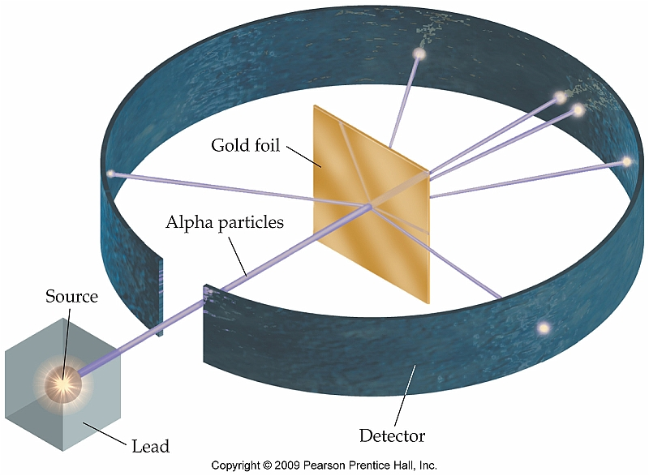
Wee Review
Reflection & Rutherford
First: Independently write down (or include diagrams) everything you remember about the Rutherford Scattering Experiment.
Then: Talk in your group about it, then we’ll regroup as a class.
Roles
Partner A: Spokesperson
Partner B: Discussion Leader
Partner C: Scribe

Slide 4
Scattering in general
Reflection & Rutherford
Scattering occurs when a particle’s path is diverted from its original trajectory.
Particles can include …
Light (photons)
Tiny partcles (e.g. electrons, alpha particles, protons)
Larger objects (e.g. ball bearings)
Types of scattering:
Reflection (light gets bounced)
Refraction (light gets bent)
Some other weird stuff with high-energy light/particles.

Slide 5
Scattering in general
Reflection & Rutherford
Scattering occurs when a particle’s path is diverted from its original trajectory.
Particles can include …
Light (photons)
Tiny partcles (e.g. electrons, alpha particles, protons)
Larger objects (e.g. ball bearings)
Types of scattering:
Reflection (light gets bounced)
Refraction (light gets bent)
Some other weird stuff with high-energy light/particles.

Slide 6
Reflection
Reflection & Rutherford
Normal line bisects our incident and reflected paths
Normal = right angle; it’s at a right angle to the tangent.
θ_{i} = θ_{r}
Tangent line is perpendicular to normal and just touches intersection of incident and reflected paths.

Slide 7
Reflection
Reflection & Rutherford
BRAINSTORM
How could we use multiple reflection events to determine the boundaries of a shape?
Roles:
Partner A: Scribe
Partner B: Spokesperson
Partner C: Discussion Leader

Slide 10
Let’s take a look at our apparatus!

Slide 11
Our Procedure
Explore the ZONE OF MYSTERY!
Roll a ball bearing down the ramp.
Record the incident path (path going in).
Record the reflected path (path going out).
Extend incident and reflected paths back to see where they intersect.
Draw in normal and tangent lines.
Repeat a bunch of times until you feel like you can ID your shape!

Slide 12
What will our data look like?

Slide 13
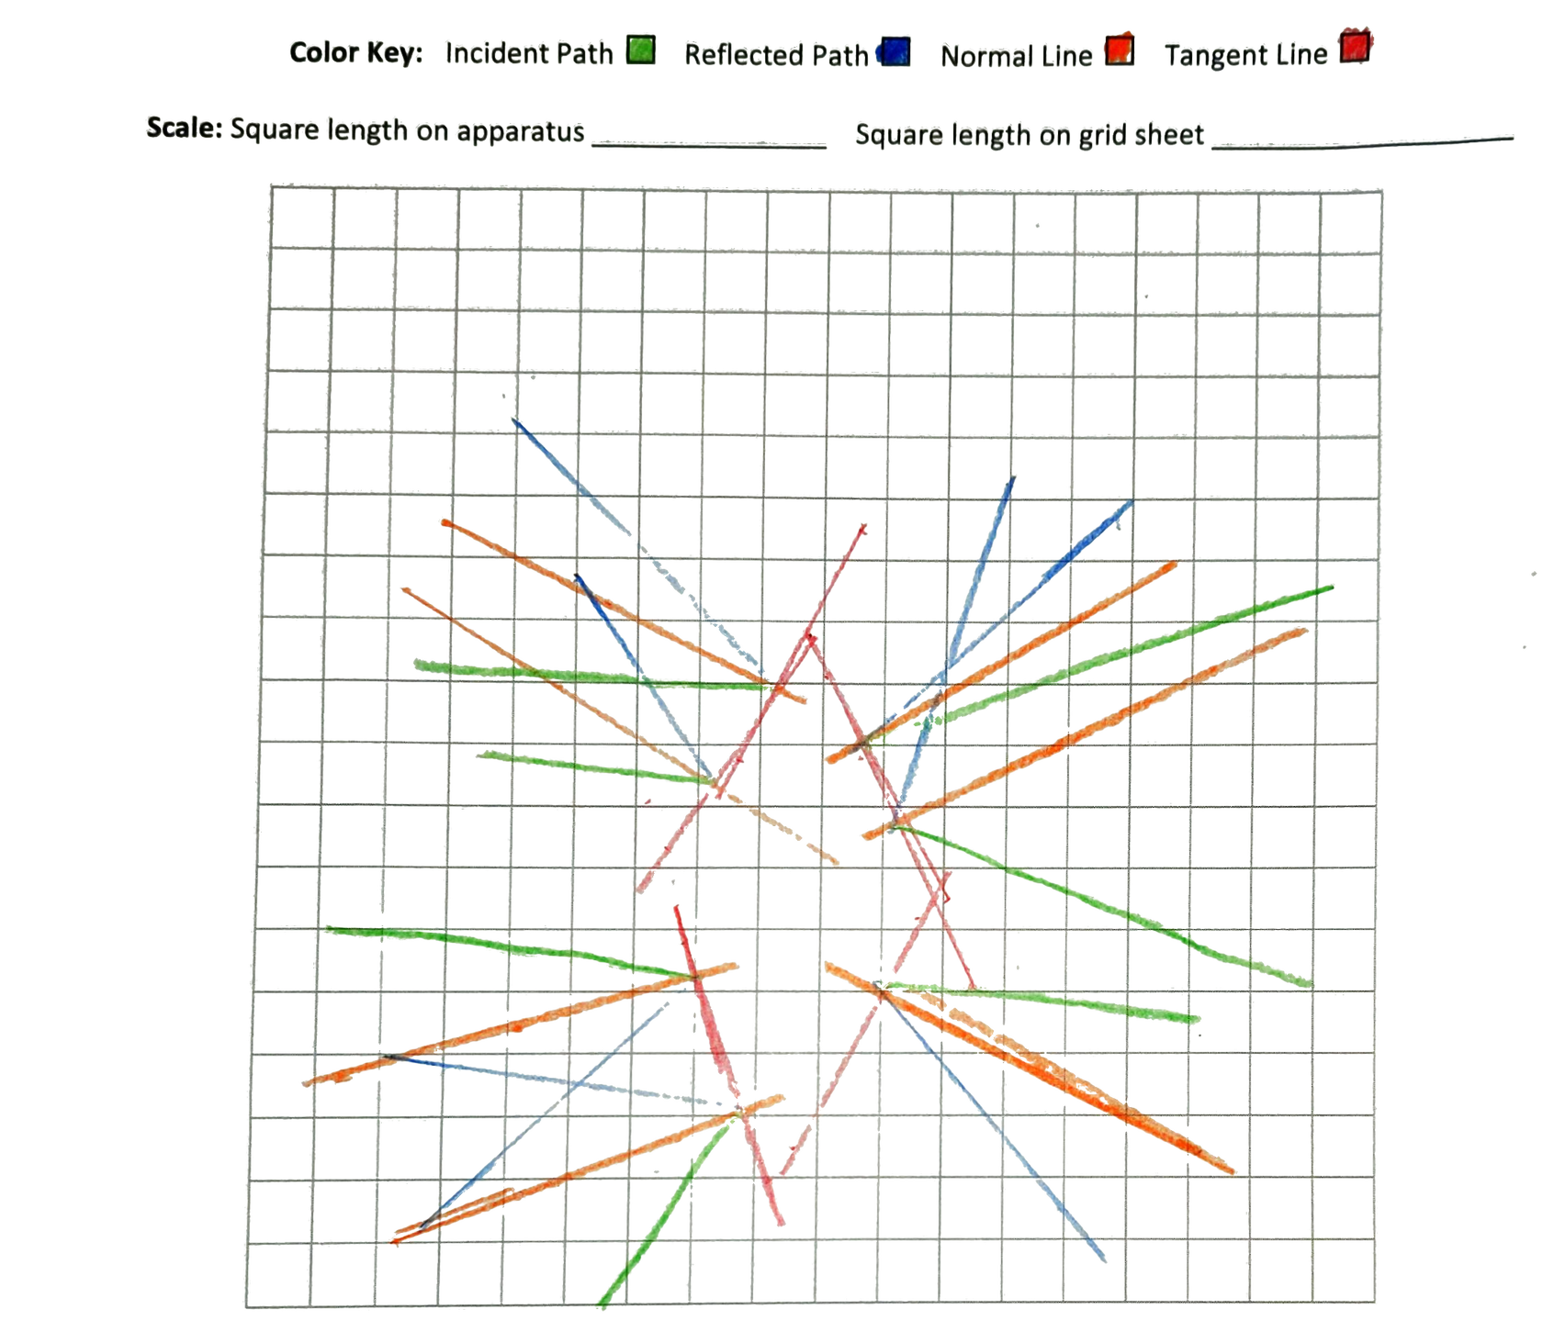
Note — these samples may or may not correspond to actual shapes in the lab!

Slide 14
Note — these samples may or may not correspond to actual shapes in the lab!

Slide 15
Note — these samples may or may not correspond to actual shapes in the lab!

Slide 16
Note — these samples may or may not correspond to actual shapes in the lab!

Slide 17
Note — these samples may or may not correspond to actual shapes in the lab!

Slide 18
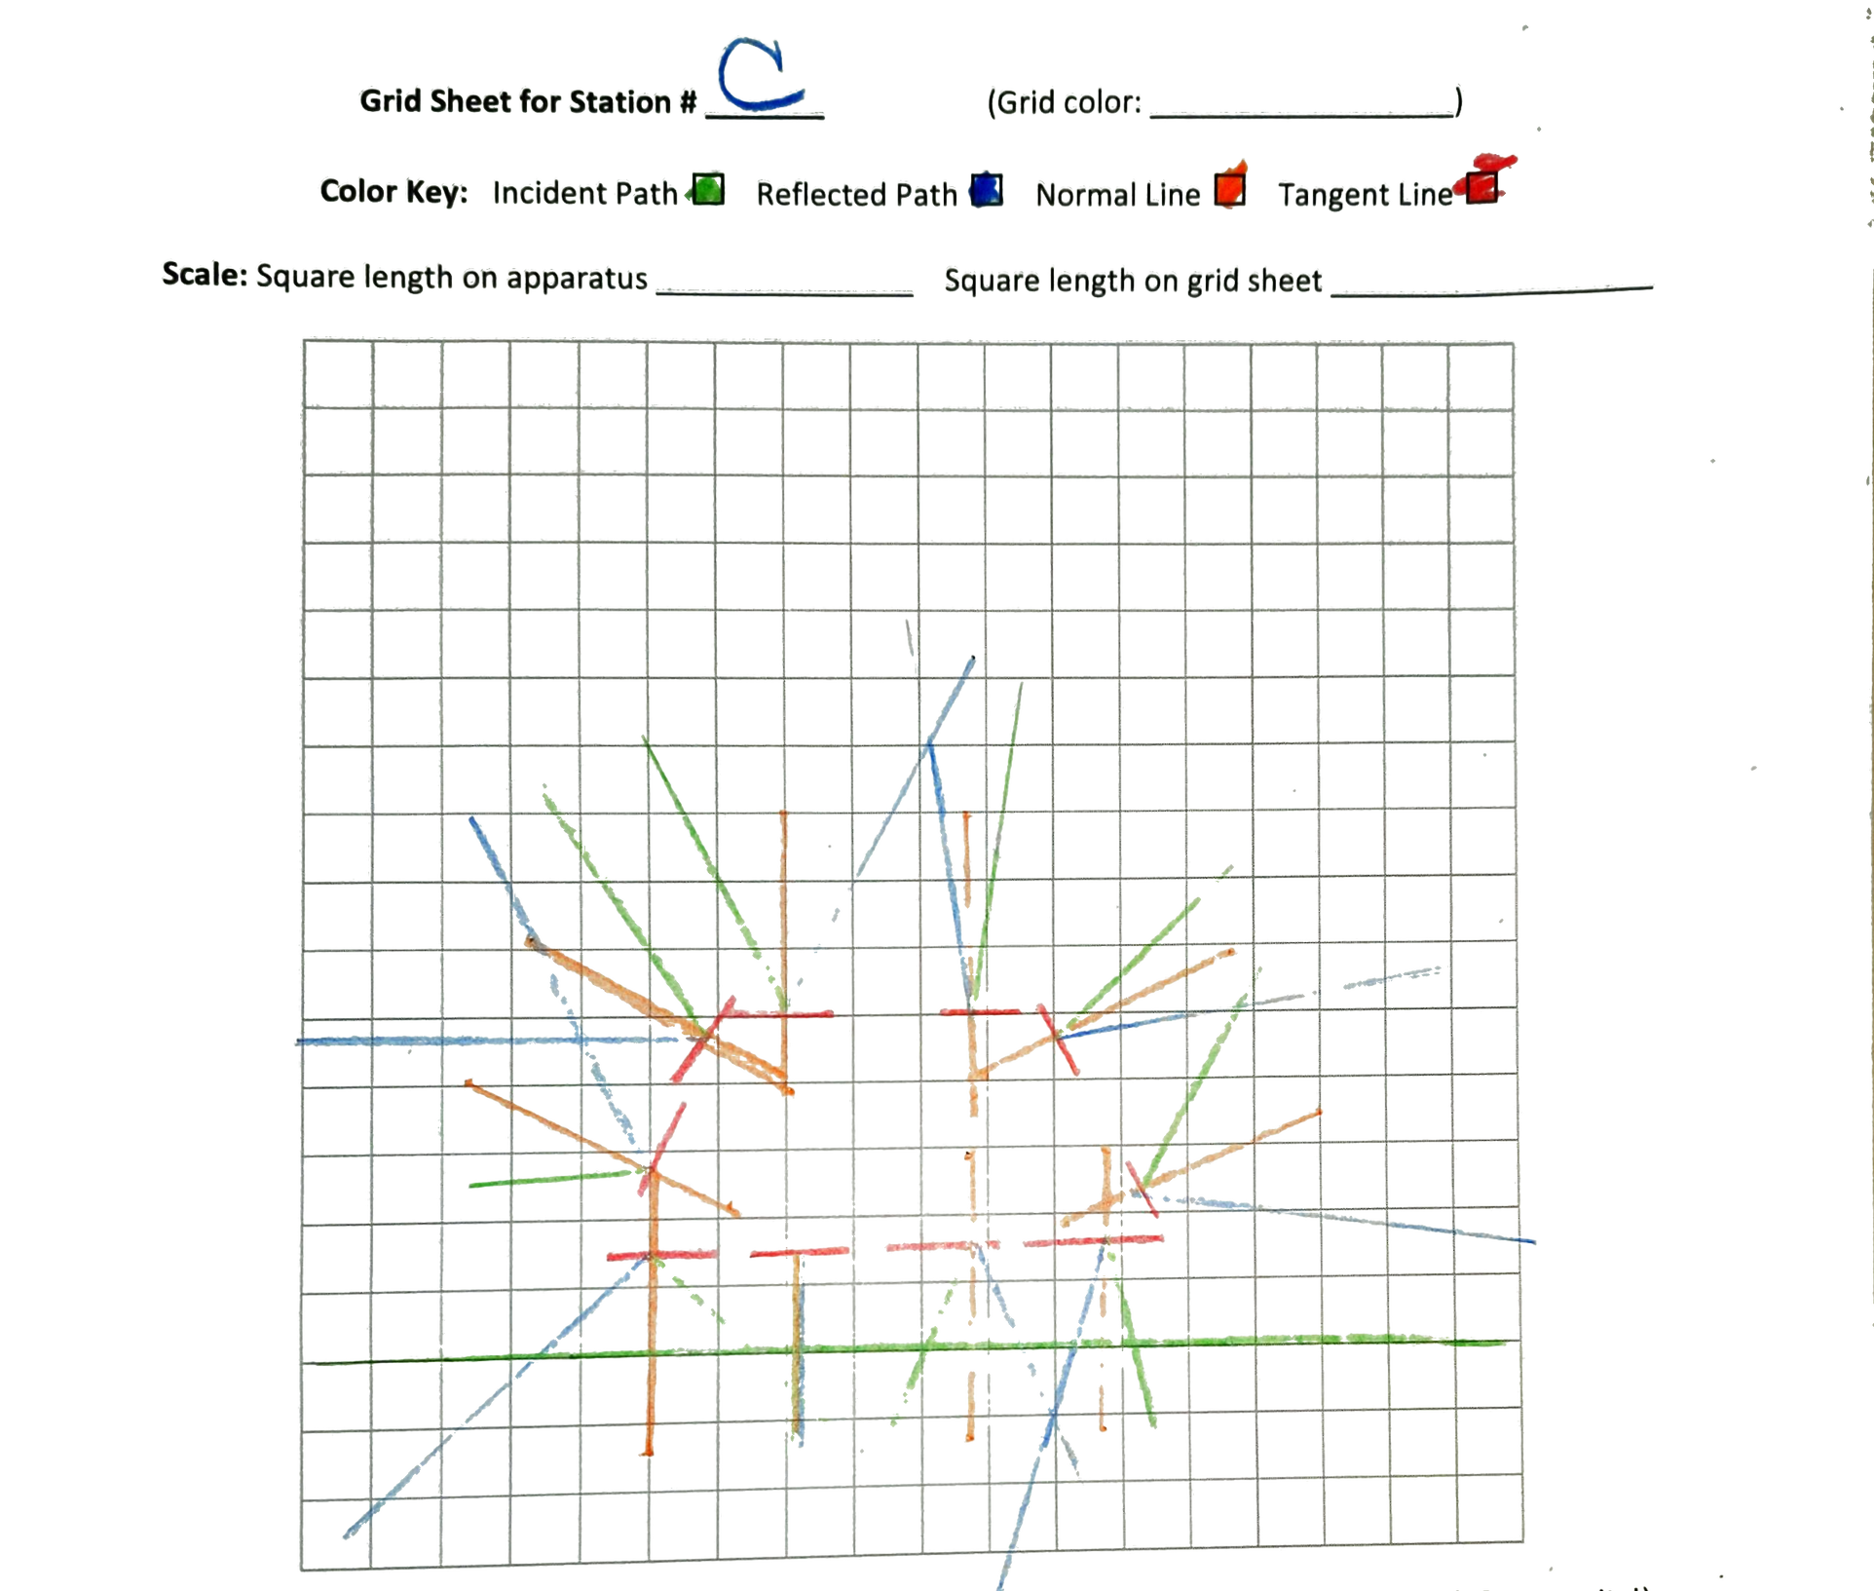
← What’s this line?

Slide 19
Think-Pair-Share
Explore the ZONE OF MYSTERY!
In your group, complete the Think-Pair-Share on page 84.
Roles
Partner A: Discussion Leader
Partner B: Scribe
Partner C: Spokesperson

Slide 20
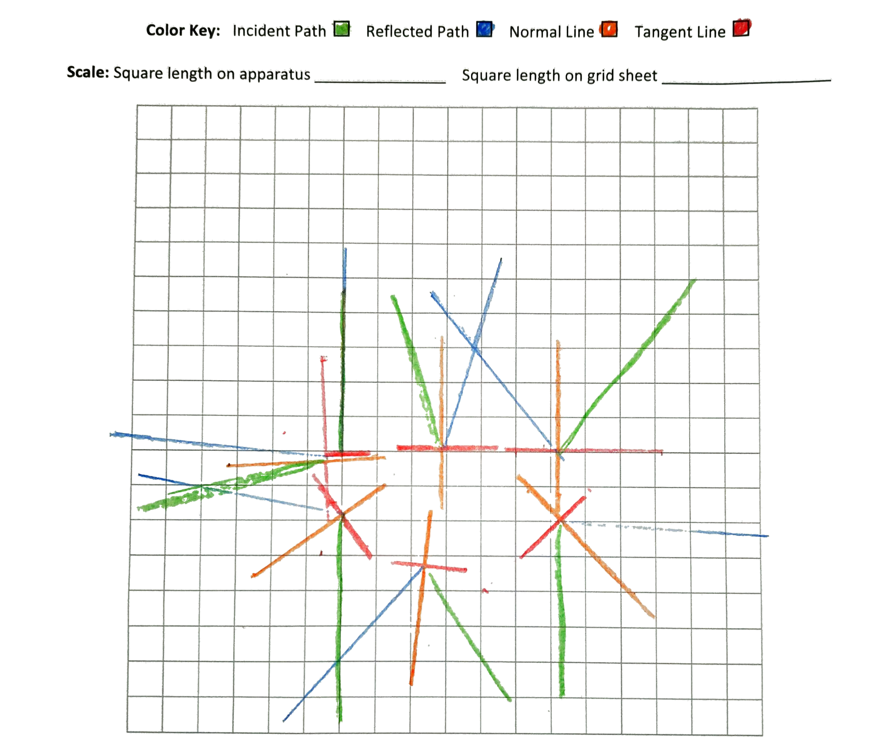
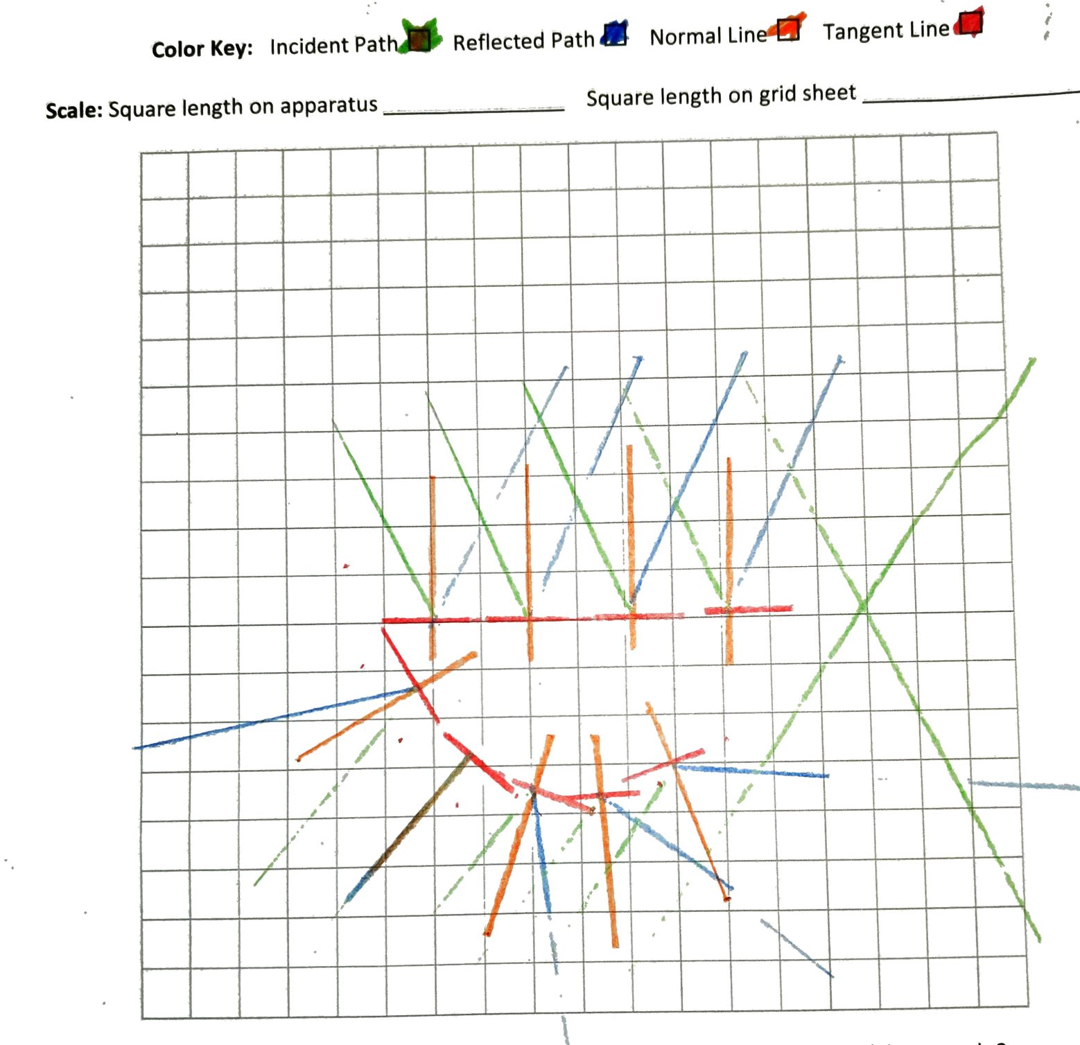
Group A’s probe
Group B’s probe

Slide 21
Calculations at scale
Scale Calculations
You now have a scale model of your shape!
How can we calculate the area of the real, actual, hidden shape?
Box counting — good for really well-aligned rectangles and basically nothing else.
Geometry & scale factors — good for weird shapes, imperfectly aligned shapes, etc.

Slide 22
Calculations at scale
Scale Calculations
You now have a scale model of your shape!
How can we calculate the area of the real, actual, hidden shape?
Box counting — good for really well-aligned rectangles and basically nothing else.
Geometry & scale factors — good for weird shapes, imperfectly aligned shapes, etc.

Slide 23
Calculating Area with a scale factor
Scale Calculations
Measure your spaces
Find the area of a grid square on the apparatus: $A_{big\text{□}}$
Find the area of a grid square on the paper: $A_{small\text{□}}$
Calculate your scale model’s area ($A_{drawing}$)
Measure the dimensions of your shape on paper.
Calculate area using those measurements and appropriate area formulas.
Convert your scale model’s area to the area of the actual wooden shape
$$A_{drawing}\left(\frac{A_{big\text{□}}}{A_{small\text{□}}}\right)=A_{IRL}$$

Slide 24
Practice!
Scale Calculations
Independently, work on the sample problem on page 81.
Then, in your small groups, compare solutions!
Roles for whole-class regroup
Partner A: Spokesperson
Partner B: Scribe
Partner C: Discussion Leader
Please note – these numbers are all hypothetical and do not necessarily correspond to our real equipment!
$$A_{drawing}\left(\frac{A_{big\text{□}}}{A_{small\text{□}}}\right)=A_{IRL}$$
A_{drawing} = area of drawn shape
A_{big□} = area of a grid square on the apparatus
A_{small□} = area of grid square on your paper
A_{IRL} = area of the real, actual, hidden shape in the Zone of Mystery

