Slide 1
Today’s Plan
Intro and Announcements
Types of Uncertainty
Precision and Accuracy
Statistics

Slide 2
Upcoming Labs
Intro and Announcements
This Week
Next Week
Gathering data on pendulums.
Analyze your own data set
Add your data to a class set
Drop-in format requires some homework on this one!
Application of our stats concepts.
Pre-lab lecture will include Excel practice!
Bring devices next Monday!

Slide 3
THIS WEEK’S SYSTEM THIS WEEK’S QUESTION
Intro and Announcements
Pendulums and human reaction time
How and why do we work with large data sets?

Slide 4
Precision and Accuracy
Precision vs. Accuracy
Precision …
How tightly clustered are your data?
How large is the uncertainty on your data?
Related to data spread
Accuracy …
How close is your measured value to the “true” value?
How close is your measured value to what you expect?
Related to BE & average.

Slide 5
Precision and Accuracy
Precision vs. Accuracy
Both accuracy and precision are ways we describe uncertainty!
How do our data deviate from…
Our expectations
E.g. do our data disagree with previous work?
From the truth
E.g. did we do something wrong in our procedure?

Slide 6
Precision and Accuracy
Precision vs. Accuracy
Let’s say we’re doing a survey on the cutthroat trout population in Lake Coeur D’Alene.
What’s the average length?
What’s the range of lengths?
We gather our data on 100 fish, then compare with accepted values.

Slide 7
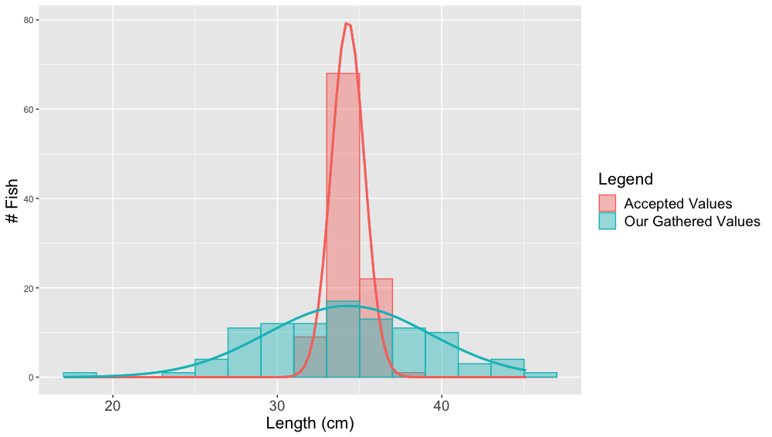
Precision and Accuracy
Precision vs. Accuracy
Cutthroat Trout Lengths

Slide 8
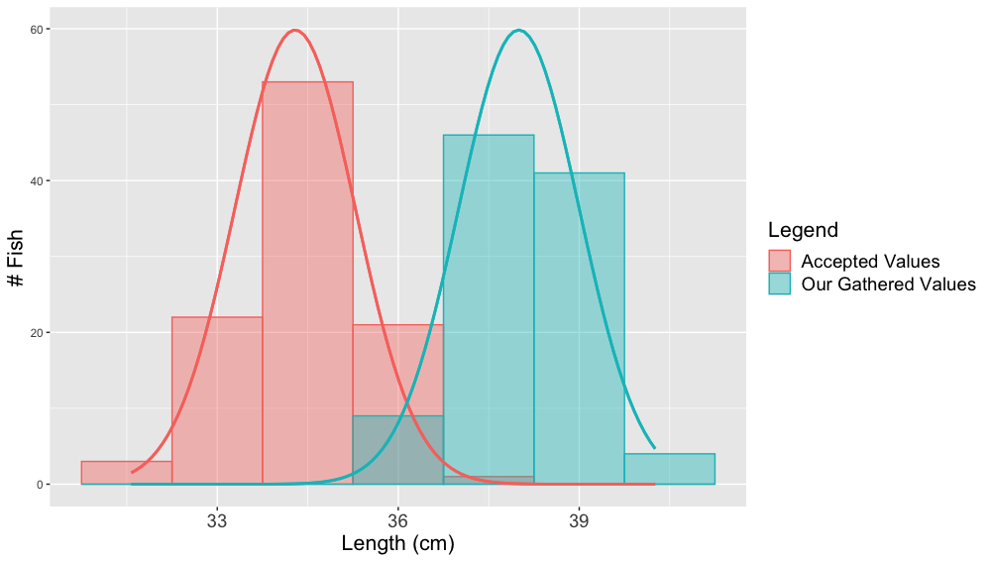
Precision and Accuracy
Precision vs. Accuracy
Cutthroat Trout Lengths

Slide 9
What is uncertainty?
Error & Uncertainty
In small groups, come up with a definition for uncertainty!
Take about a minute and then we’ll regroup.

Slide 10
Types of Uncertainty
Error & Uncertainty
Reading error
Due to the limits of your measuring device.
Applies exclusively to direct measurements.
Affects the precision: larger reading error = less precise measurements.
Random error
Not repeatable: will not happen the same way every time.
Affects the precision: more random error = larger spread.
Systematic error
Consistent and repeatable: same effect from trial to trial/measurement to measurement.
Affects the accuracy: more systematic error = large shift in BE away from expectation.

Slide 11
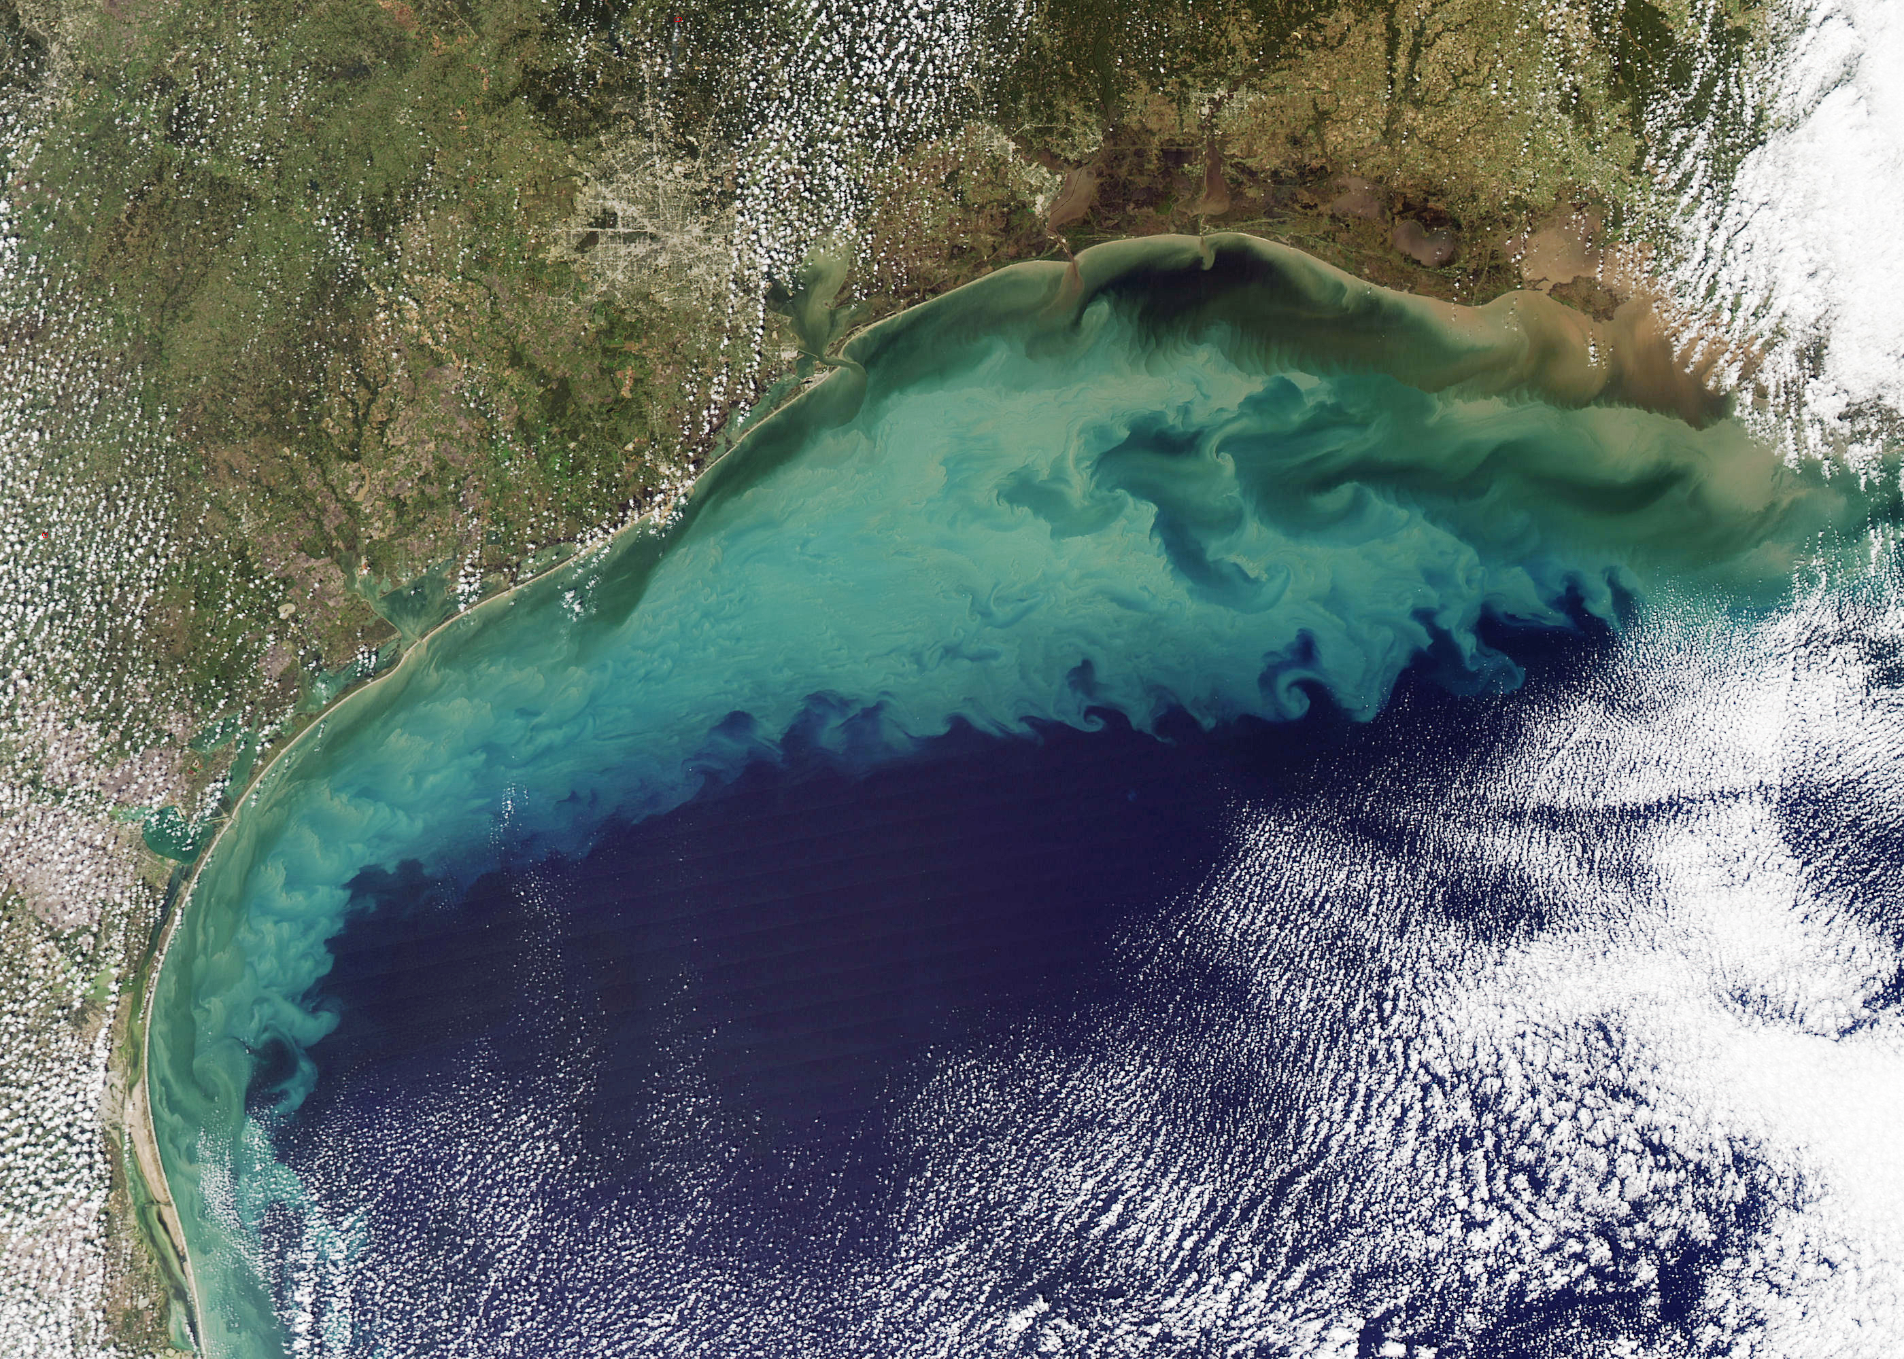
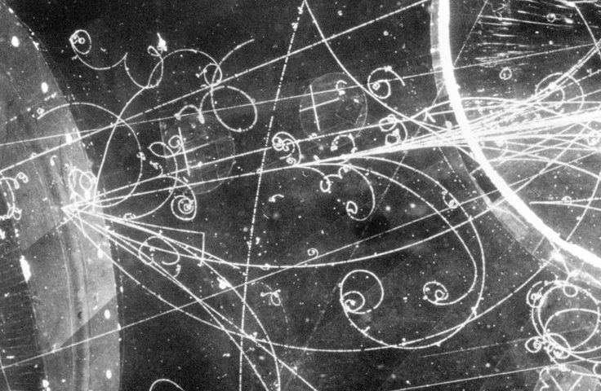
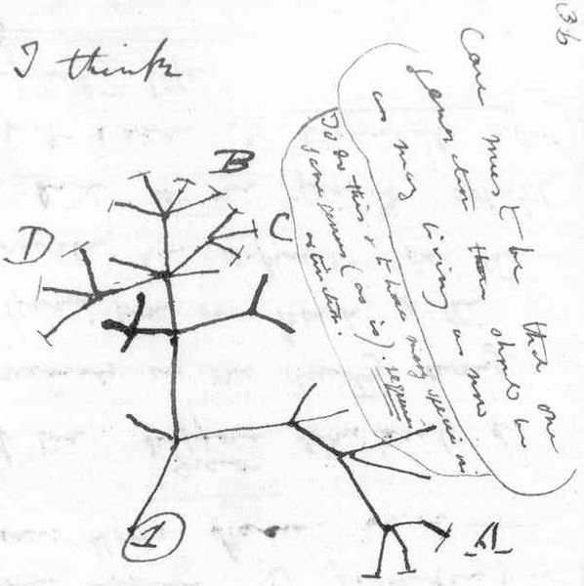
Some places where we find randomness in the natural world

Slide 12
Examples??
Error & Uncertainty
Take a minute and try to come up with one example for each category.
Like, an example of reading error could be “The RE of our scales in lab is 0.1 g.”
I will call for volunteers!

Slide 13
WE WILL NOT USE HUMAN ERROR IN THIS CLASS
Error & Uncertainty
Types of uncertainty tell us how sources of uncertainty affected our data (not why or what caused it!)
Increase range/spread → random error
Shift of BE away from expected value → systematic error
… even if the reason for that increase/shift was a human mistake!

Slide 14
Sample Problem!
Error & Uncertainty
Take a few minutes to work through this in small groups or solo.

Slide 15
Sample Problem!
Error & Uncertainty
Source | Type | Why?
The digital scale you’re using won’t settle on one value, but wobbles up and down. | Random | Electronic noise can introduce some imprecision/spread.
Your calipers read to the nearest 0.01 cm. | Reading | Intrinsic to the device
You accidentally used $4πr^{3}$ instead of $\frac{4}{3}πr^{3}$ when calculating the volumes of a set of marbles. | Systematic | This mistake will affect all your volume values the same way!
To find the mass of each marble, you put a bowl on the scale to prevent them from rolling. You do not subtract the mass of the bowl when recording your values. | Systematic | All your mass values will include the mass of the bowl!
You’re measuring the sizes of lentil beans and your values vary from lentil to lentil. | Random | Natural variation causes imprecision/spread.

Slide 16
Think-Pair-Share
Error & Uncertainty
Take a minute to discuss in small groups!

Slide 17
Statistics
Statistics
Statistics lets us …
Easily work with large data sets.
Quantify all types of uncertainty (random, reading, systematic).
Learn what is normal for a system.
E.g. Is there naturally a lot of variation in this system?

Slide 18
Statistics
Statistics
We’re going to begin …
… working with larger data sets
… doing experiments where we can’t assume that reading error is our only type of error
The data analysis we’ve been doing isn’t going to cut it anymore!

Slide 19
Statistical Values
Statistics
Measures of Central Tendency
Measures of Spread
Summarize a data set → best estimate!
Common examples:
Average
Median
Mode
Tell us how spread out a data set is → uncertainty!
Common examples:
Standard deviation
Standard error
Associated error

Slide 20
How we’ll use these values
Statistics
When we do stats in our class, we’ll use …
Average as our best estimate.
Associated error as our uncertainty.
So we’ll report like this:
Average + Associated Error [units]

Slide 21
Why?
Statistics
Averages are good measures of central tendencies for normal distributions
Bell curve, symmetric about the mean
We are going to assume our data are normally distributed!
Associated Error defines the boundaries of a 95% confidence interval.
What kind of data look normal for this system?
“If we were to repeat this experiment a gajillion more times, there is a 95% probability that the real true value we’re looking for falls between Avg – AE and Avg + AE.”

Slide 22
Calculating Average
Statistics
$$\overline{x}=\sum_{i=0}^{n}{\frac{x_{i}}{n}}= \frac{x_{0}+x_{1}+x_{2}+ …+x_{n}}{n}$$
Okay but it’s the 21st century so let’s use Excel:
=AVERAGE(highlight the range of cells containing your raw data)

Slide 23
Calculating AE
Statistics
Calculate the standard deviation, $σ$.
In Excel: STDEV.S()
Warning! Not STDEV.P or STDEV.A!
Calculate the standard error, SE
$SE=\frac{σ }{\sqrt{n}}$, where n is your sample size.
In Excel: =cell where your SD is/SQRT(# data points you have)
Calculate the associated error, AE.
$AE=SE∗1.96$
In Excel: =cell where your SE is*1.96

Slide 24
Stats in Excel
Statistics
It’s on the inside back cover!
To get … | Function/Process | Example with fake cell references
Average | AVERAGE() | =AVERAGE(A2:A20)
Standard Deviation $$σ$$ | STDEV.S() | =STDEV.S(A2:A20)
Standard Error | $$SE=\frac{σ }{\sqrt{n}}$$ | =C3/SQRT(C1)
Associated Error | $$AE=SE⋅1.96$$ | =C4*1.96

Slide 25
Brainstorm!
Precision vs. Accuracy
If a large amount of random error affected your data, how would that be reflected in your stats?
If a large amount of systematic error affected your data, how would that be reflected in your stats?

Slide 26
To Summarize
Precision vs. Accuracy
Random error affects the spread.
Large AE, large random error.
Systematic error shifts the average.
Large systematic error, BE way far off from expected value.

